Slide 1
Topics in SW Engineering – Cloud Computing: Some Patterns and Concepts
© Donald F. Ferguson, 2022

Slide 2

Stateless, Sessions Example
2 Topics in SW Engineering – Cloud Computing: Lecture 9, Some Concepts
© Donald F. Ferguson, 2022

Slide 3
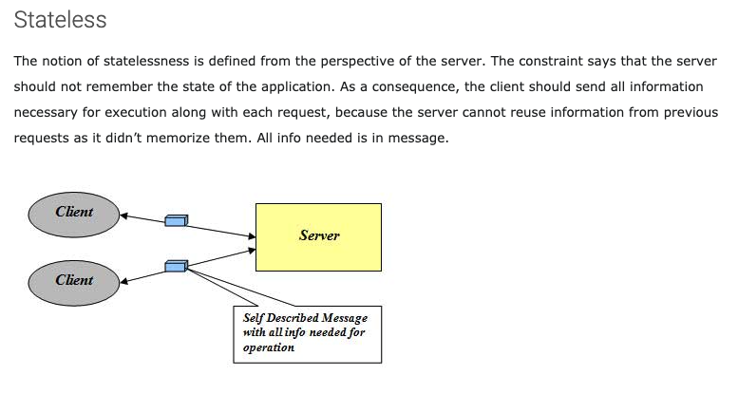
Stateless
http://mrbool.com/rest-architectural-elements-and-constraints/29339

Slide 4
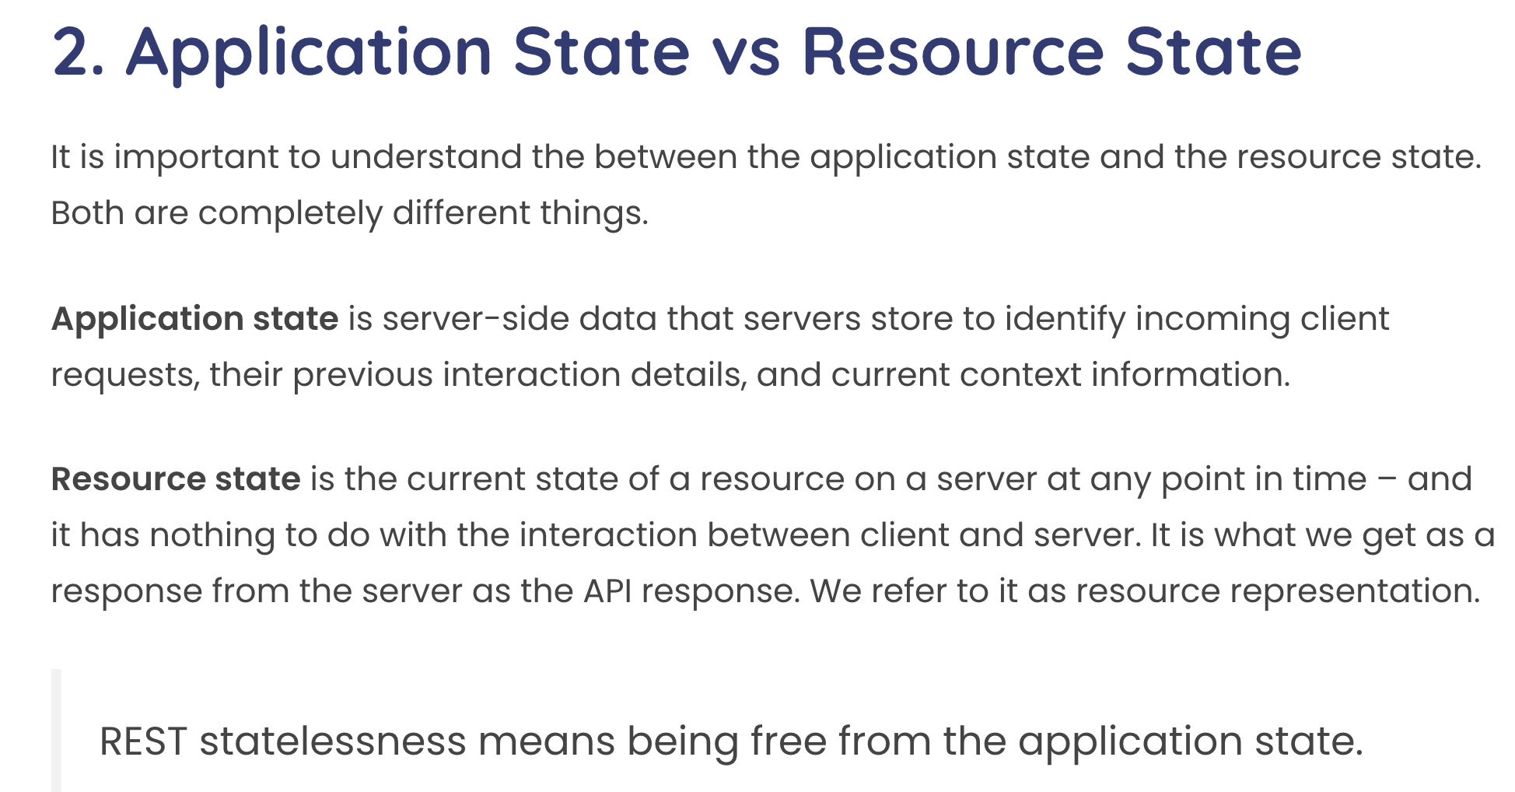
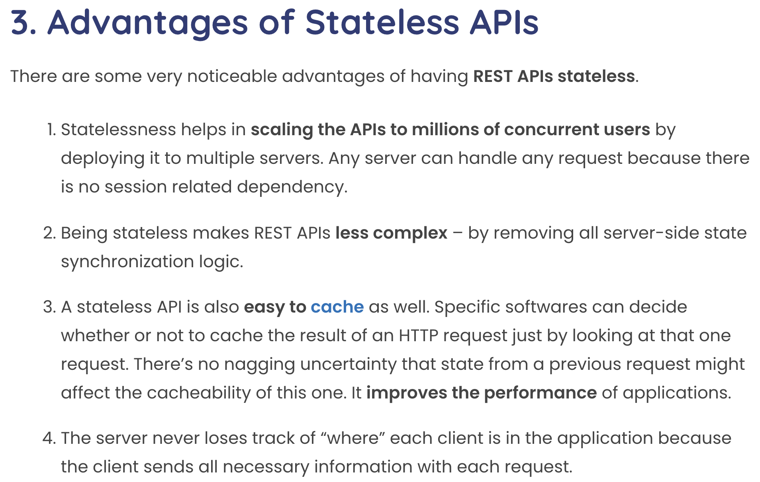
Statelessness
This concept can be confusing with experience with other approach to session state.
Some application frameworks did/do keep session state on the server.
Application servers and frameworks have various support for “session state,” e.g. https://flask-session.readthedocs.io/en/latest/

Slide 5
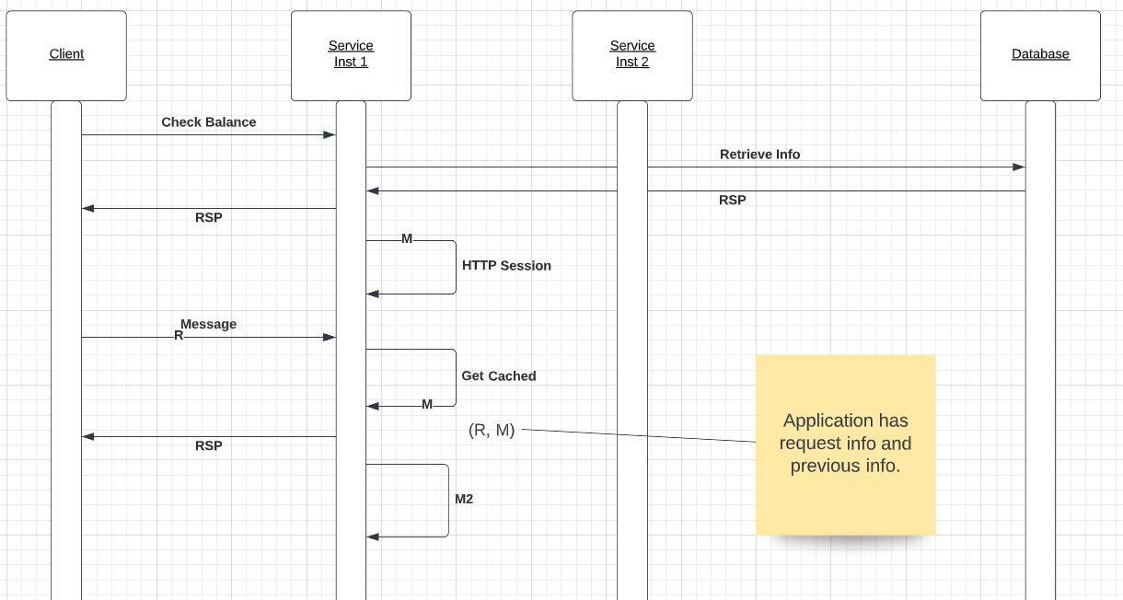
Stateful Conversation – Simple Example

Slide 6
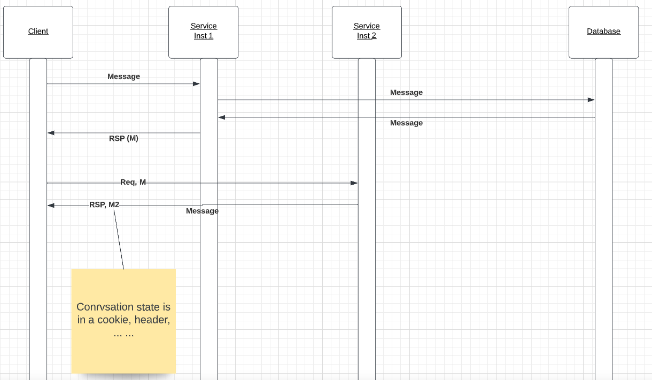
Stateless – Simple Example

Slide 7
Simple Example from Databases
“In computer science, a database cursor is a mechanism that enables traversal over the records in a database. Cursors facilitate subsequent processing in conjunction with the traversal, such as retrieval, addition and removal of database records. The database cursor characteristic of traversal makes cursors akin to the programming language concept of iterator.” (https://en.wikipedia.org/wiki/Cursor_(databases))
Database Server
create_cursor()
fetch()
fetch()
close()
Cursor
... ...
... ...
Client Application
Cursor
Database Server
The client and database server share the “state of the cursor.”
This is separate from the state of the data.
This hinders scalability and fault tolerance if there are multiple database servers in a cluster.

Slide 8
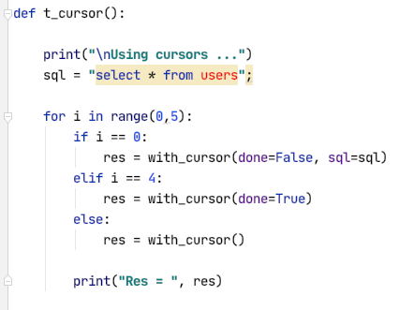
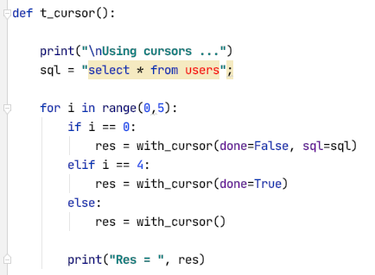
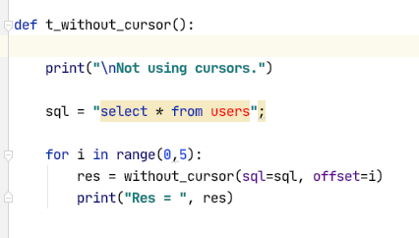
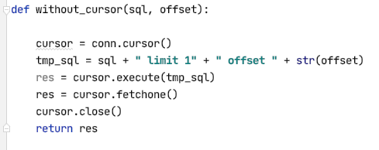
Some Code

Slide 9
Summary
This session explained the concept of “stateless” in REST.
Most of the cloud deployment of our existing products will be stateful and have conversation state in memory.
That is fine. There are design patterns for handling the situation.
Our infrastructure will support “affinity.”
User affinity.
Session affinity.
Clients get “pinned” to a microservice instances based on affinity.
Ansys Lab and the Product Instance Manager support this model.

Slide 10

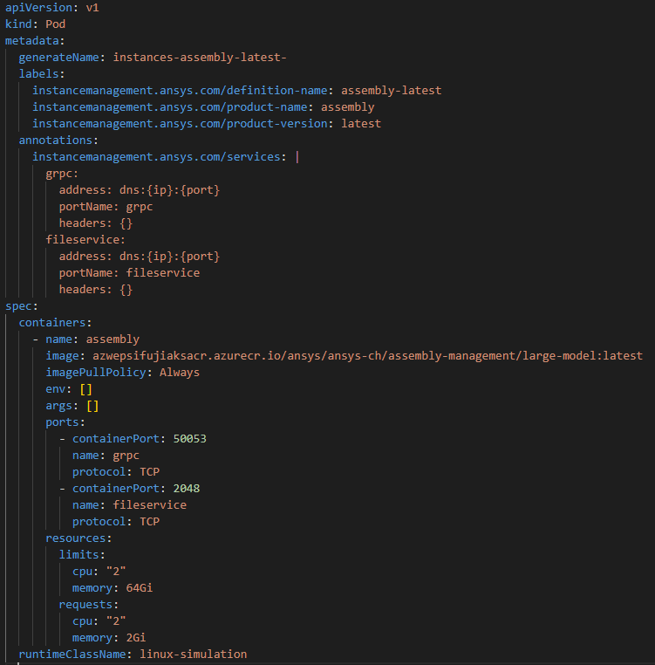
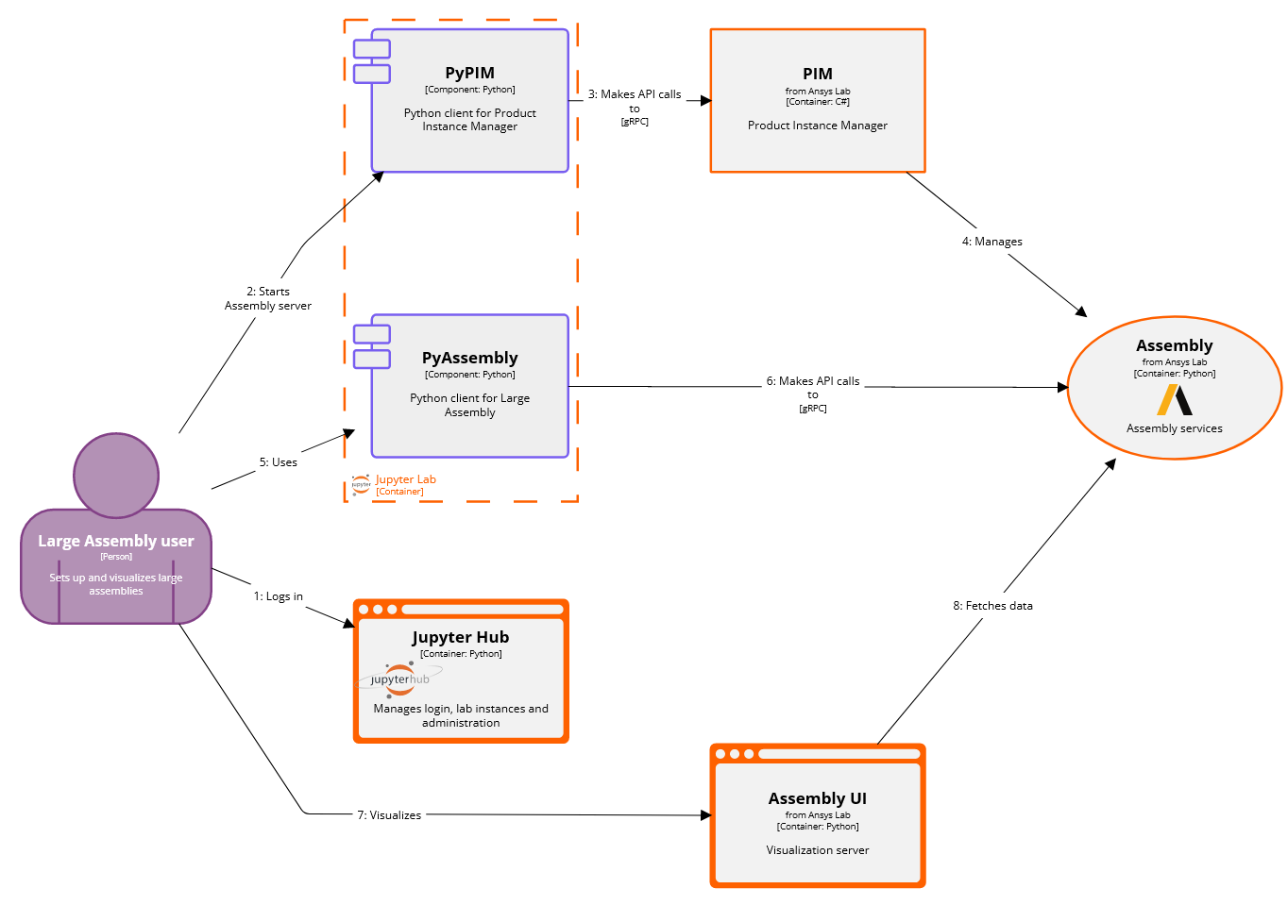
Product Instance Management (PIM API & PyPIM client)
Simple config-based creation, deletion, tracking of product aas
“Assembly” PIM config = Kubernetes yaml
Implementation of the PIM API for Kubernetes
Specs driven by the dev team
Specs driven by Fuji’s infra

Slide 11
XYZ Scaling
11 Topics in SW Engineering – Cloud Computing: Lecture 9, Some Concepts
© Donald F. Ferguson, 2022

Slide 12
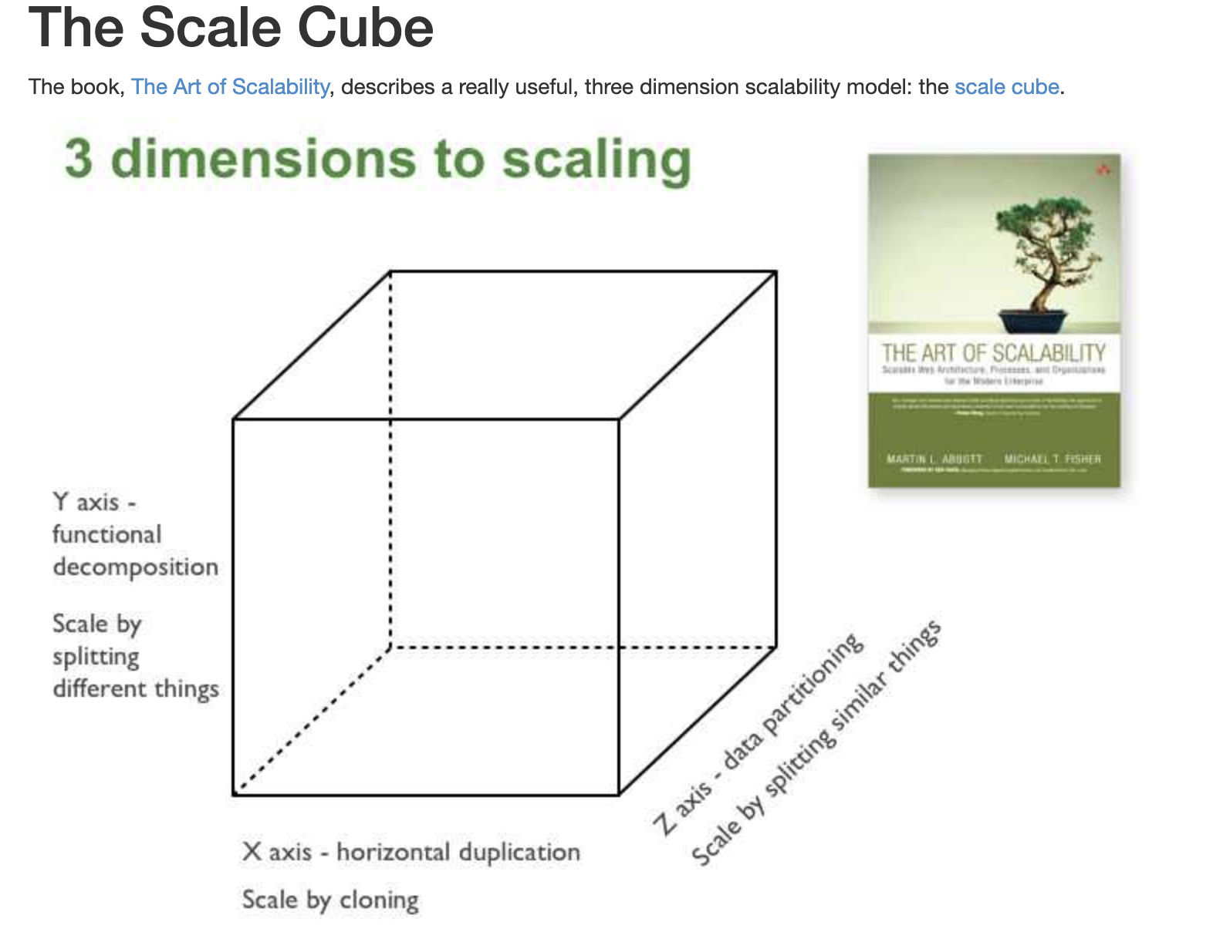
Microservices Scalability Cube
https://microservices.io/articles/scalecube.html
X-axis scaling consists of running multiple copies of an application behind a load balancer. If there are N copies then each copy handles 1/N of the load. This is a simple, commonly used approach of scaling an application.
Y-axis axis scaling splits the application into multiple, different services. Each service is responsible for one or more closely related functions.
When using Z-axis scaling each server runs an identical copy of the code. In this respect, it’s similar to X-axis scaling. The big difference is that each server is responsible for only a subset of the data. Some component of the system is responsible for routing each request to the appropriate server

Slide 13
XYZ – Scaling
There are three dimensions.
A complete solution/environment typical is a mix and composition of patterns.
Application design and data access determines opitions.

Slide 14
SOLID
14 Topics in SW Engineering – Cloud Computing: Lecture 9, Some Concepts
© Donald F. Ferguson, 2022

Slide 15
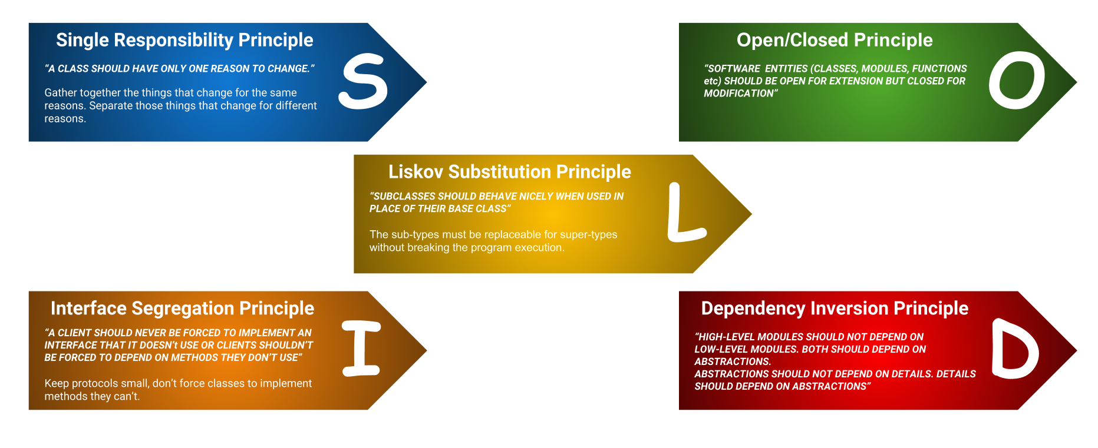
SOLID Principles (Enumerate, Will Cover Later)
“In software engineering, SOLID is a mnemonic acronym for five design principles intended to make software designs more understandable, flexible, and maintainable. ” (https://en.wikipedia.org/wiki/SOLID)
The concept started with OO but applies to microservices.

Slide 16
12 Factor Applications
16 Topics in SW Engineering – Cloud Computing: Lecture 9, Some Concepts
© Donald F. Ferguson, 2022

Slide 17
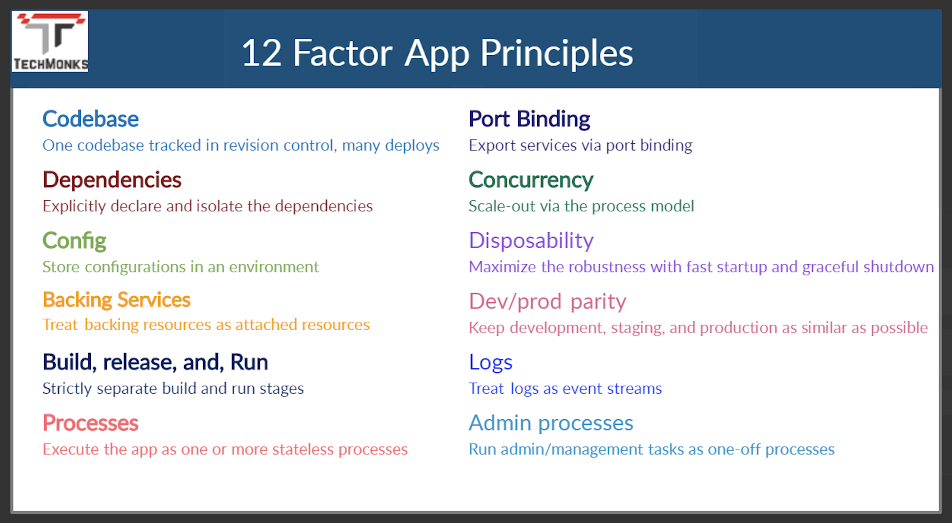
12 Factor Applications
https://dzone.com/articles/12-factor-app-principles-and-cloud-native-microser

Slide 18
Scaling
18 Topics in SW Engineering – Cloud Computing: Lecture 9, Some Concepts
© Donald F. Ferguson, 2022

Slide 19
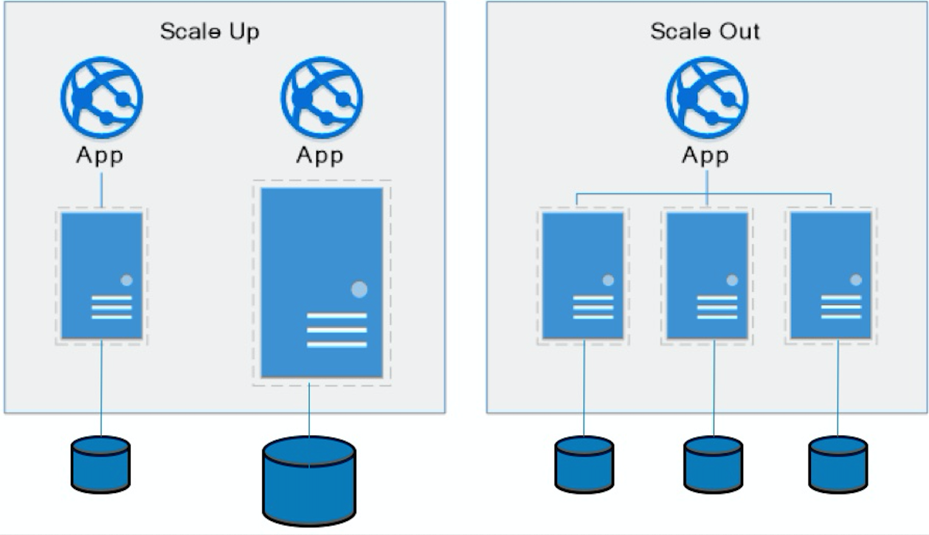
Approaches to Scalability
Scalability is the property of a system to handle a growing amount of work by adding resources to the system.
Replace system with a bigger machine, e.g. more memory, CPU, ... ...
Scale-up:
Less incremental.
More disruptive.
More expensive for extremely large systems.
Does not improve availability
Scale-out:
Incremental cost.
Data replication enables availability.
Does not work well for functions like JOIN, referential integrity, ... ...
Add another system.

Slide 20
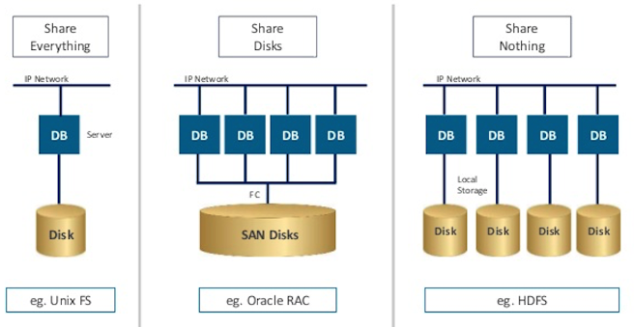
Disk Architecture for Scale-Out
Share disks:
Is basically scale-up for data/disks. You can use NAS, SAN and RAID.
Isolation/Integrity requires distributed locking to control access from multiple database servers.
Share nothing:
Is basically scale-out for disks.
Data is partitioned into shards based on a function f() applied to a key.
Can improve availability, at the code consistency, with data replication.
There is a router that sends requests to the proper shard based on the function.

Slide 21
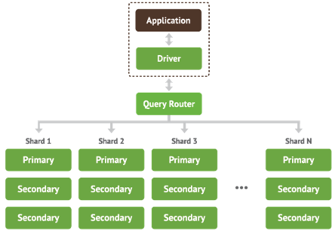
Shared Nothing, Scale-Out
MongoDB Sharding
DynamoDB Partitioning

Slide 22
Microservice Layers
22 Topics in SW Engineering – Cloud Computing: Lecture 9, Some Concepts
© Donald F. Ferguson, 2022

Slide 23
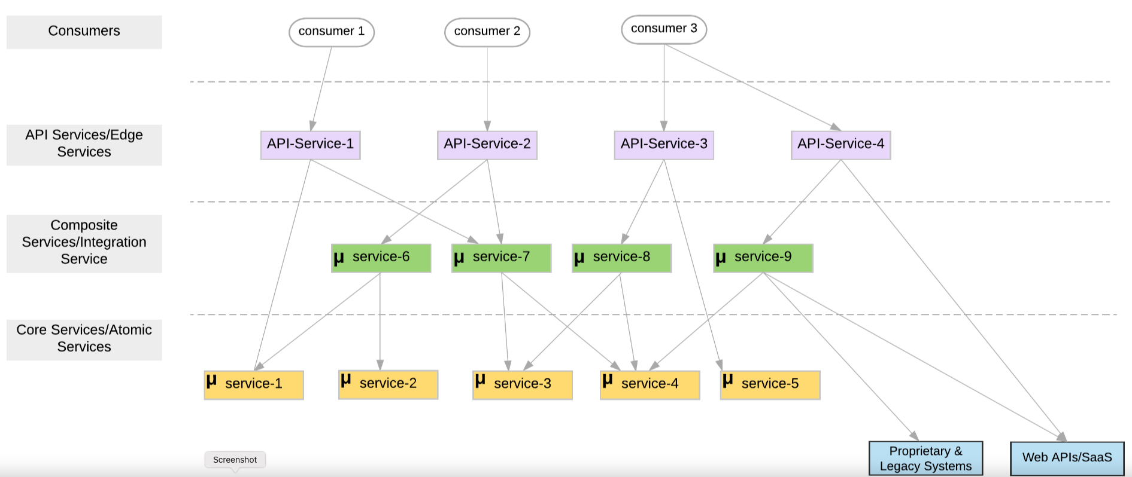
Microservice Layers

Slide 24
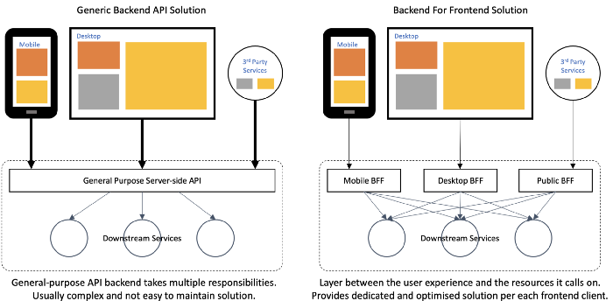
Backend for Frontend

Slide 25
Architecture Patterns
25 Topics in SW Engineering – Cloud Computing: Lecture 9, Some Concepts
© Donald F. Ferguson, 2022

Slide 26
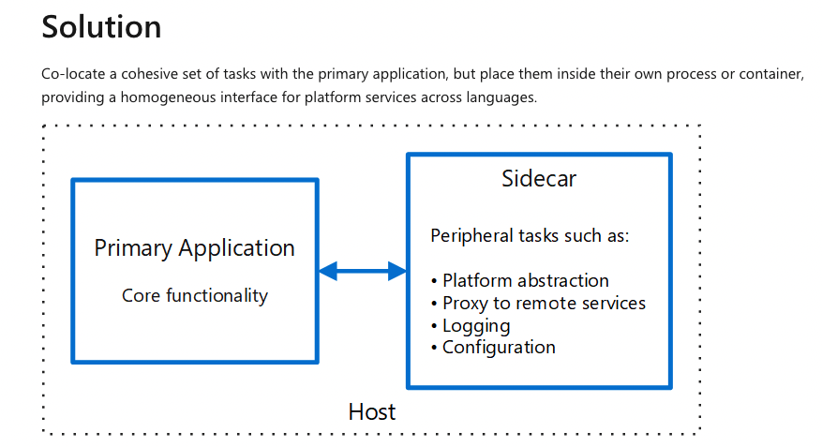
Sidecar Pattern
A sidecar is independent from its primary application in terms of runtime environment and programming language, so you don't need to develop one sidecar per language.
The sidecar can access the same resources as the primary application. For example, a sidecar can monitor system resources used by both the sidecar and the primary application.
Because of its proximity to the primary application, there's no significant latency when communicating between them.
Even for applications that don't provide an extensibility mechanism, you can use a sidecar to extend functionality by attaching it as its own process in the same host or sub-container as the primary application.

Slide 27
NoSQL DynamoDB
27 Topics in SW Engineering – Cloud Computing: Lecture 9, Some Concepts
© Donald F. Ferguson, 2022

Slide 28
Core Transaction Concept is ACID Properties
http://slideplayer.com/slide/9307681
ACID
Atomic
“ALL OR NOTHING”
Transaction cannot be subdivided
Consistent
Transaction → transforms database from one consistent state to another consistent state
Isolated
Transactions execute independently of one another
Database changes not revealed to users until after transaction has completed
Durable
Database changes are permanent
The permanence of the database’s consistent state

Slide 29
ACID Properties (httpwww.tutorialspoint.com/dbms/dbms_transaction.htm)
A transaction is a very small unit of a program and it may contain several low-level tasks. A transaction in a database system must maintain Atomicity, Consistency, Isolation, and Durability − commonly known as ACID properties − in order to ensure accuracy, completeness, and data integrity.
Atomicity − This property states that a transaction must be treated as an atomic unit, that is, either all of its operations are executed or none. There must be no state in a database where a transaction is left partially completed. States should be defined either before the execution of the transaction or after the execution/abortion/failure of the transaction.
Consistency − The database must remain in a consistent state after any transaction. No transaction should have any adverse effect on the data residing in the database. If the database was in a consistent state before the execution of a transaction, it must remain consistent after the execution of the transaction as well.
Durability − The database should be durable enough to hold all its latest updates even if the system fails or restarts. If a transaction updates a chunk of data in a database and commits, then the database will hold the modified data. If a transaction commits but the system fails before the data could be written on to the disk, then that data will be updated once the system springs back into action.
Isolation − In a database system where more than one transaction are being executed simultaneously and in parallel, the property of isolation states that all the transactions will be carried out and executed as if it is the only transaction in the system. No transaction will affect the existence of any other transaction.

Slide 30
Serializability
“In concurrency control of databases, transaction processing (transaction management), and various transactional applications (e.g., transactional memory^{[3]} and software transactional memory), both centralized and distributed, a transaction schedule is serializable if its outcome (e.g., the resulting database state) is equal to the outcome of its transactions executed serially, i.e. without overlapping in time. Transactions are normally executed concurrently (they overlap), since this is the most efficient way. Serializability is the major correctness criterion for concurrent transactions' executions. It is considered the highest level of isolation between transactions, and plays an essential role in concurrency control. As such it is supported in all general purpose database systems.” (https://en.wikipedia.org/wiki/Serializability)

Slide 31
CAP Theorem
Consistency
Every read receives the most recent write or an error.
Availability
Every request receives a (non-error) response – without guarantee that it contains the most recent write.
Partition Tolerance
The system continues to operate despite an arbitrary number of messages being dropped (or delayed) by the network between nodes

Slide 32
Consistency Models
STRONG CONSISTENCY: Strong consistency is a consistency model where all subsequent accesses to a distributed system will always return the updated value after the update.
WEAK CONSISTENCY: It is a consistency model used in distributed computing where subsequent accesses might not always be returning the updated value. There might be inconsistent responses.
EVENTUAL CONSISTENCY: Eventual consistency is a special type of weak consistency method which informally guarantees that, if no new updates are made to a given data item, eventually all accesses to that item will return the last updated value.

Slide 33
BASE
Eventually-consistent services are often classified as providing BASE (Basically Available, Soft state, Eventual consistency) semantics, in contrast to traditional ACID (Atomicity, Consistency, Isolation, Durability) guarantees. Rough definitions of each term in BASE:
Basically Available: basic reading and writing operations are available as much as possible (using all nodes of a database cluster), but without any kind of consistency guarantees (the write may not persist after conflicts are reconciled, the read may not get the latest write)
Soft state: without consistency guarantees, after some amount of time, we only have some probability of knowing the state, since it may not yet have converged
Eventually consistent: If the system is functioning and we wait long enough after any given set of inputs, we will eventually be able to know what the state of the database is, and so any further reads will be consistent with our expectations

Slide 34
Eventual Consistency
Availability and scalability via
Multiple, replicated data stores.
Read goes to “any” replica.
PUT/POST/DELETE
Goes to any replica
Change propagate asynchronously
GET may not see the latest value if the update has not propagated to the replica.
There are several algorithms for conflict resolution
Detect and handle in application.
Clock/change vectors/version numbers
… …
get
put

Slide 35
ACID – BASE (Simplistic Comparison)
(Or other strategy)

Slide 36
Approaches to Scalability
Scalability is the property of a system to handle a growing amount of work by adding resources to the system.
Replace system with a bigger machine, e.g. more memory, CPU, ... ...
Scale-up:
Less incremental.
More disruptive.
More expensive for extremely large systems.
Does not improve availability
Scale-out:
Incremental cost.
Data replication enables availability.
Does not work well for functions like JOIN, referential integrity, ... ...
Add another system.

Slide 37
Disk Architecture for Scale-Out
Share disks:
Is basically scale-up for data/disks. You can use NAS, SAN and RAID.
Isolation/Integrity requires distributed locking to control access from multiple database servers.
Share nothing:
Is basically scale-out for disks.
Data is partitioned into shards based on a function f() applied to a key.
Can improve availability, at the code consistency, with data replication.
There is a router that sends requests to the proper shard based on the function.

Slide 38
Shared Nothing, Scale-Out
MongoDB Sharding
DynamoDB Partitioning

Slide 39
Database-as-a-Service
39 Topics in SW Engineering – Cloud Computing: Lecture 9, Some Concepts
© Donald F. Ferguson, 2022

Slide 40
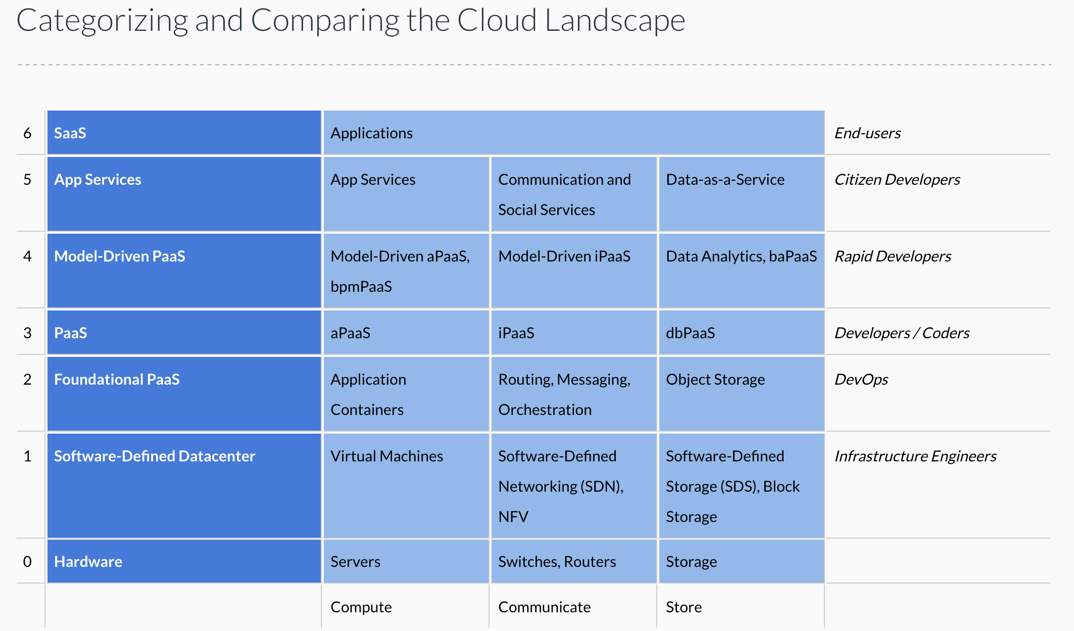
Cloud Concepts – One Perspective
http://www.theenterprisearchitect.eu/blog/2013/10/12/the-cloud-landscape-described-categorized-and-compared/

Slide 41
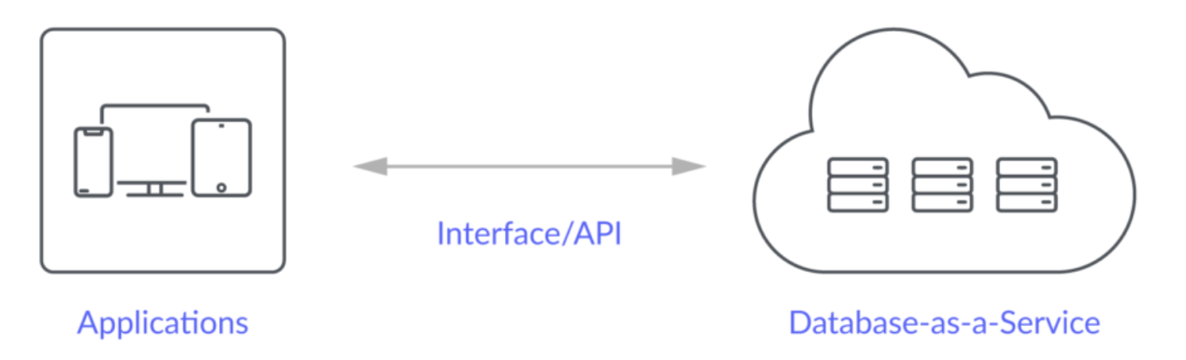
Database-as-a-Service
“A cloud database is a database that typically runs on a cloud computing platform and access to the database is provided as-a-service. There are two common deployment models: users can run databases on the cloud independently, using a virtual machine image, or they can purchase access to a database service, maintained by a cloud database provider. Of the databases available on the cloud, some are SQL-based and some use a NoSQL data model.
Database services take care of scalability and high availability of the database. Database services make the underlying software-stack transparent to the user.” (Wikipedia)
Let’s take a look at 3: Relational Data Service, Dynamo DB, MongoDB (Compass)

Slide 42
DynamoDB
42 Topics in SW Engineering – Cloud Computing: Lecture 9, Some Concepts
© Donald F. Ferguson, 2022

Slide 43
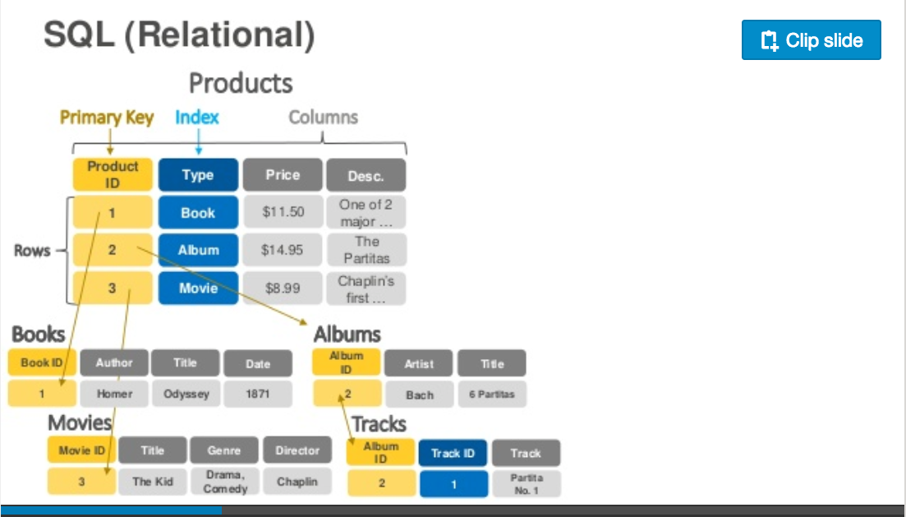
DynamoDB – Relational
https://www.slideshare.net/AmazonWebServices/introduction-to-amazon-dynamodb-73191648

Slide 44
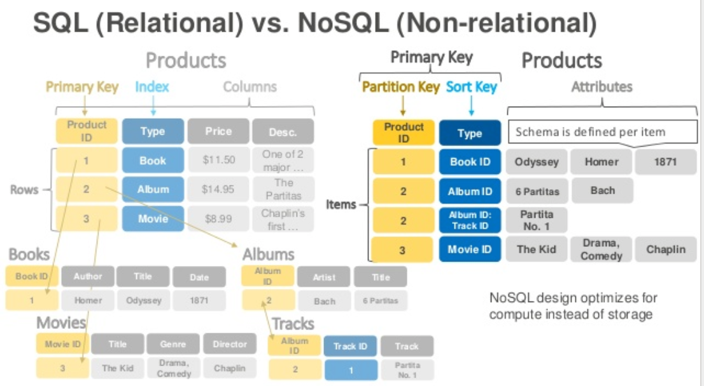
DynamoDB Data Model
Dynamo DB – Relational

Slide 45
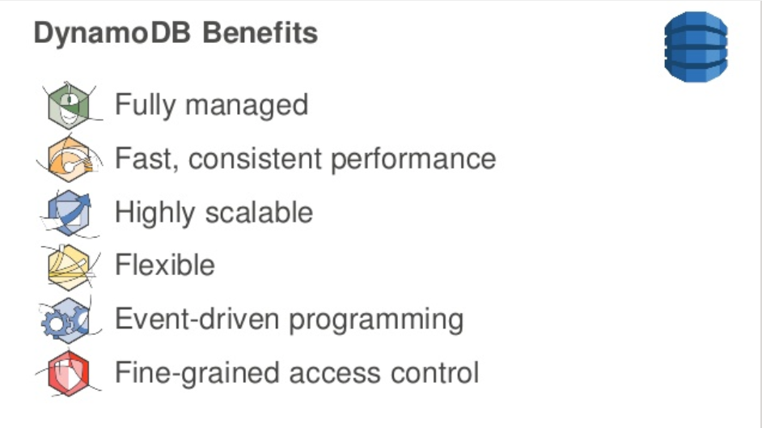
DynamoDB
DynamoDB Benefits

Slide 46
DynamoDB Hashing
DynamoDB – Hash Key

Slide 47
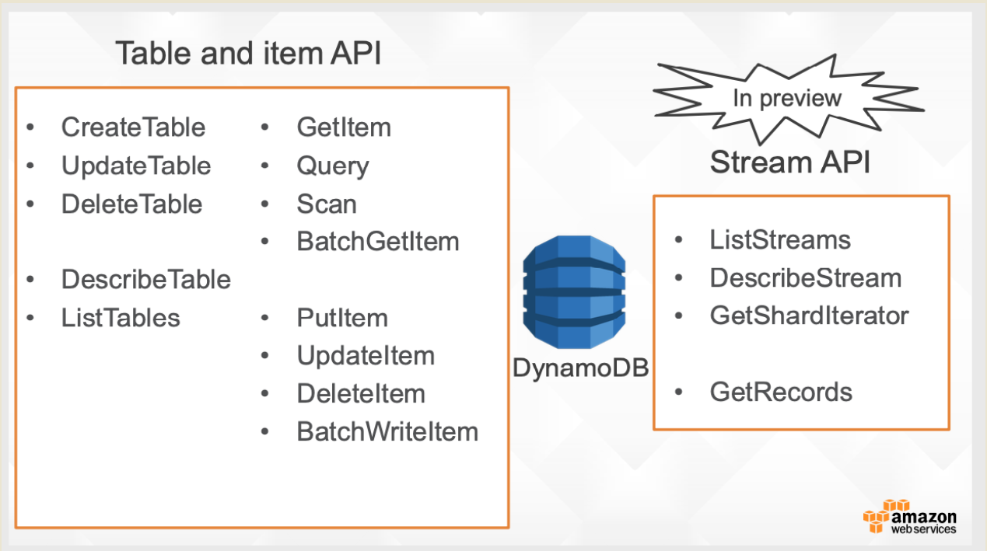
DynamoDB Model
47 Topics in SW Engineering – Cloud Computing: Lecture 9, Some Concepts
© Donald F. Ferguson, 2022

Slide 48
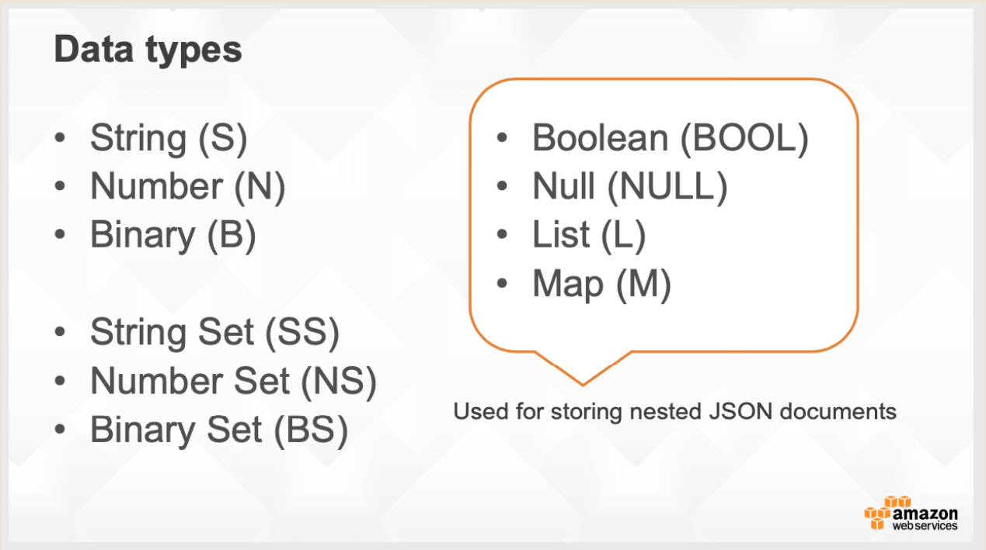
DynamoDB Model
48 Topics in SW Engineering – Cloud Computing: Lecture 9, Some Concepts
© Donald F. Ferguson, 2022

Slide 49
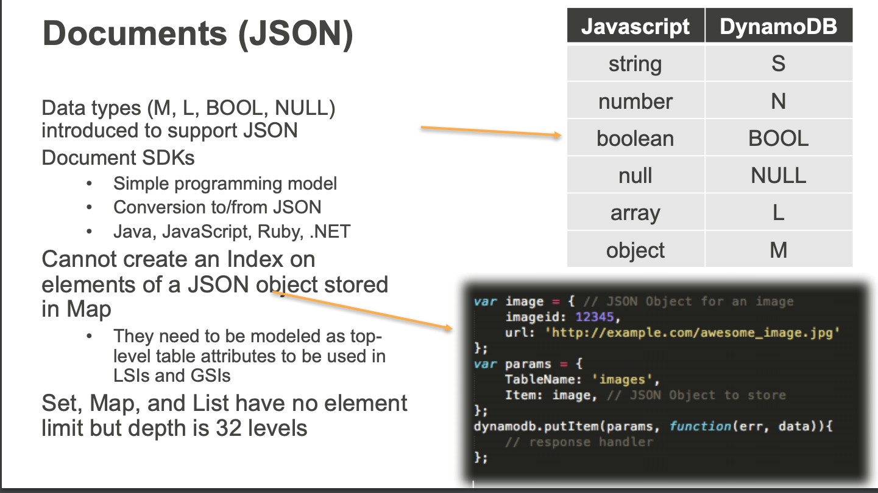
DynamoDB Model
49 Topics in SW Engineering – Cloud Computing: Lecture 9, Some Concepts
© Donald F. Ferguson, 2022

Slide 50
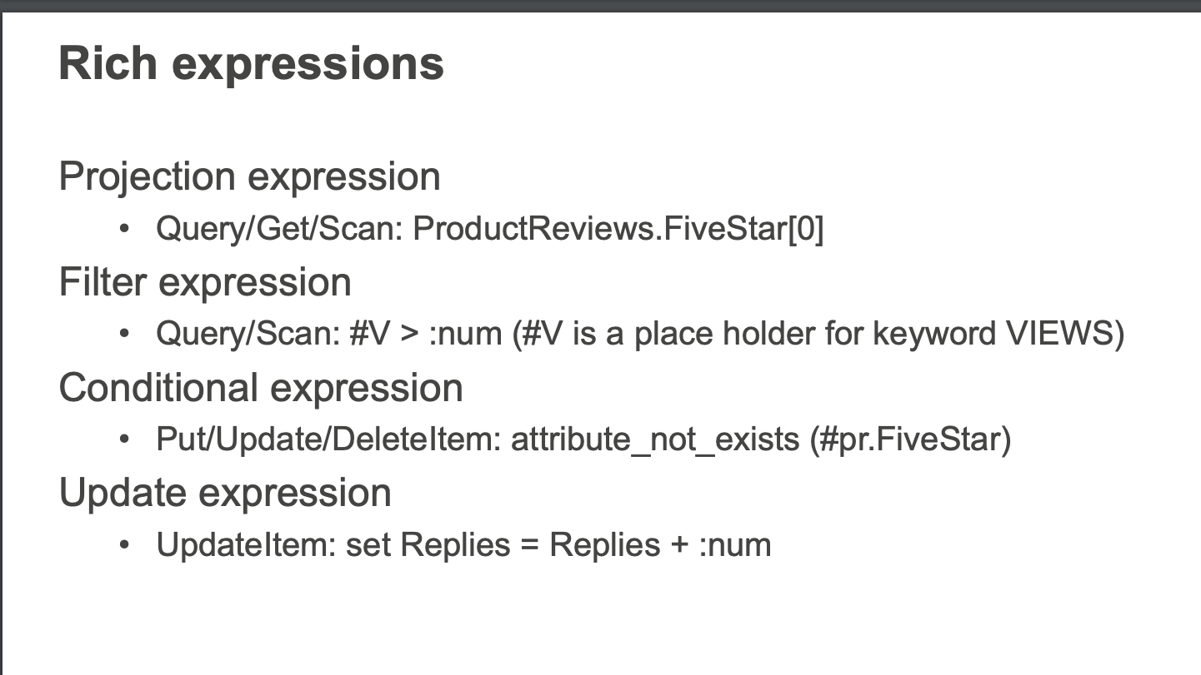
DynamoDB Model
50 Topics in SW Engineering – Cloud Computing: Lecture 9, Some Concepts
© Donald F. Ferguson, 2022

Slide 51
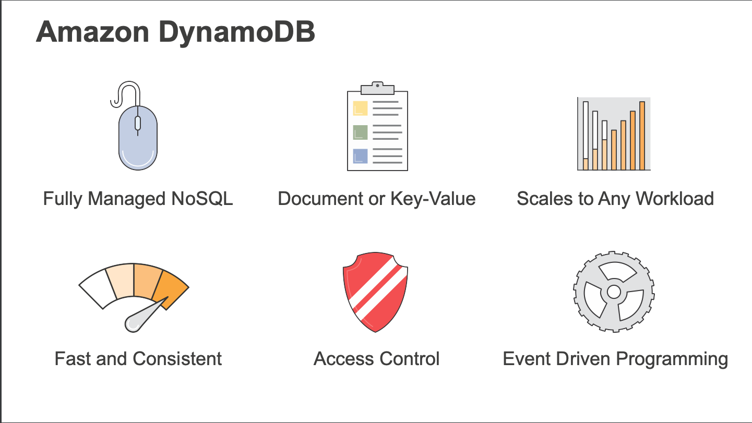
DynamoDB
51 Topics in SW Engineering – Cloud Computing: Lecture 9, Some Concepts
© Donald F. Ferguson, 2022

Slide 52
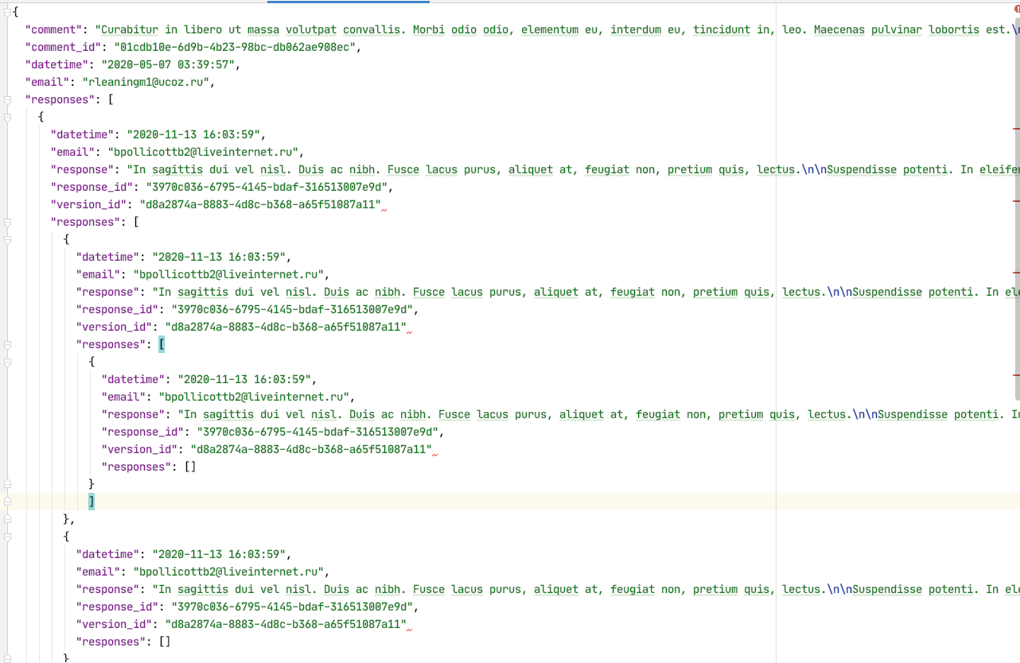
Document Databases – Semi-Structured Schema
The relation model has difficulties with some types of data:
Columns that are lists or maps
Nesting – things inside things
Discover you need a modified schema when you get a piece of data.
etc.
All of these are common for documented like data:
Threaded discussions.
Documents.
... ...
Document DBs emerged to handle these scenarios.
52 Topics in SW Engineering – Cloud Computing: Lecture 9, Some Concepts
© Donald F. Ferguson, 2022

Slide 53
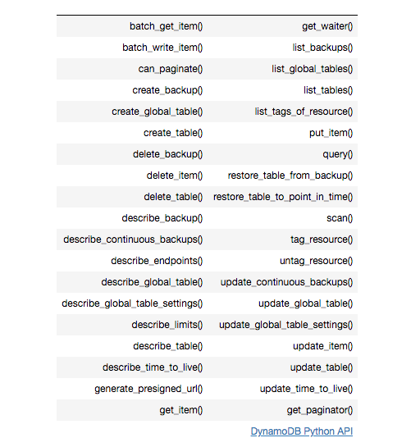
DynamoDB Summary
Achieves much greater scalability and performance than RDBMs
Does not support some RDBMs capabilities:
Referential integrity.
JOIN
Queries limited to key fields.
Non-key field queries are always scans.
Data model better fit for semi-structured data models and good fit for JSON
Maps
Lists

